Slide 1
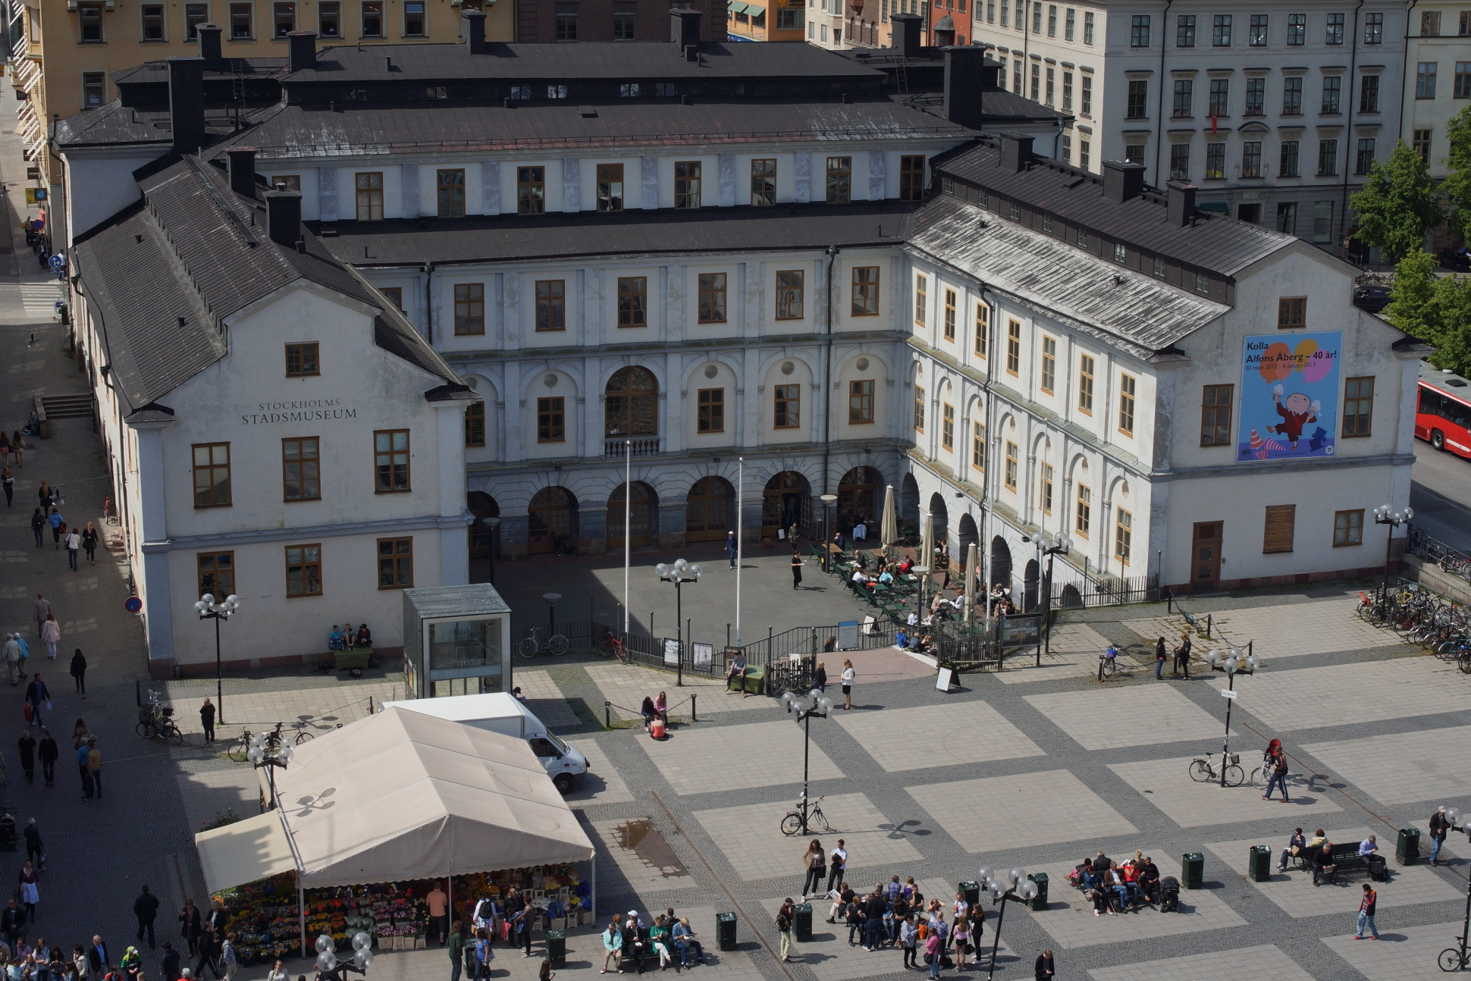
The Digital City Museum of Stockholm
Making historical heritage available on the Internet
Sten-Åke Sändh

Slide 2
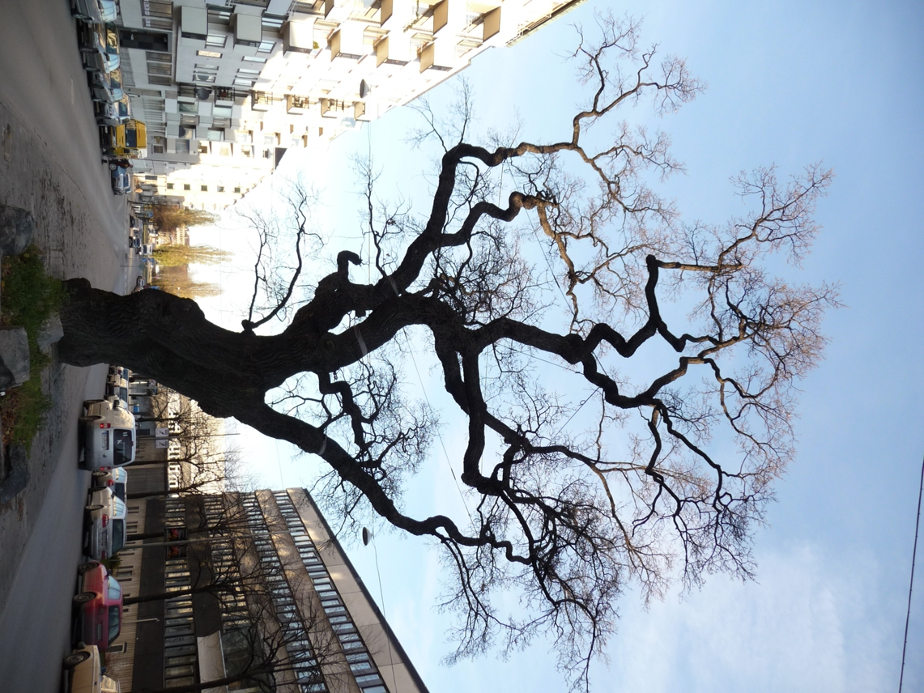
The Oak project
The Digital City Museum
of Stockholm
Photography: Ingrid Johansson
Presentation: Sten-Åke Sändh
Notes:
Vi har valt Eken som symbol för vår nya e-tjänst.

Slide 3
Background

Slide 4

Project Eken
(”Eken” means Oak and is old slang for Stockholm)
The Digital City Museum of Stockholm – the new Internet window of the
City Museum of Stockholm
A common system for publishing all digital assets of the City Museum, the Medieval Museum and the research on Stockholm
”The City Museum at your fingertips!”
Notes:
Vi behövde ha ett namn.

Slide 5
Two main design targets when the museum applied for funding of the project in 2009
Efficiently publish all our digital assets both externally and internally and make it possible to search through all types of material with one single search tool.
Make the photo production work flow of the museum’s ”Photo Unit” more efficient. We have 3,5 miljon pictures and managed barely to digitalise around 3 000 per year, before we got the new system.

Slide 6
Open Data
The year 2011, the City of Stockholm launched an ”Open data” initiative. The intention was/is to make as much of the City’s digital data accessible to the public also in a machine readable form.
The Digital City Museum makes it possible for the City Museum to meet the demands for ”Open Data”.

Slide 7
A choise of design: Consolidation or Integration
We found that integration would be a much faster, more efficient, cheaper, smarter and less risky way. FotoWare:s DAM-system (Digital Asset Management) provided most of the tools we needed to integrate data from very different systems and datasources in a pretty easy and efficient manner .
SQL Server Integration Services integrates all the systems in the back end – plumbing on a system level
FotoWare intergrates all the different types of data we have by indexing the XML-metadata tied to all dataobjects - plumbing on the metadata level

Slide 8
Stockholms
källan
(The Stockholm source)
The digital City museum
Kringla
(application based on
K-samsök)
Europeana
(joint european
search project)
Film and sound with
metadata
K- samsök (joint search project)
(swedish cultural heritage data)
FotoWare
SQL Server
Integration
Services
File
based
data
system Interface
table
Documents with
metadata
Stockholm’s
geodata
platform
Picture files with
metadata
Platina
(accounting DB)
USB
harddisks
Photo-graphy DB
Artefakt
(artefacts)
Acquisition
DB
Visual Archive DB
SSM Art DB
Bibkat
(library DB)
City art DB
Stora fynd
(archeology)
Notes:
Bilden ser ut så här.

Slide 9
Positive effects
Efficient publishing of all types of pictures and both internally and externally
One common search interface
Scalable storge with duplicate control – one single truth – increased data integrity
”All can see” and ”all can access” – a transparent and more efficient organisation
A complete integration- and automation platform – efficient integration both internally and externally
New possibilities to interact with our systems for the public but also for our own staff when working out ”in the field” through traditional web browsers in telephones and computers or Iphone- and Andriod Apps.

Slide 10
system OVERVIEW - servERS

Slide 11
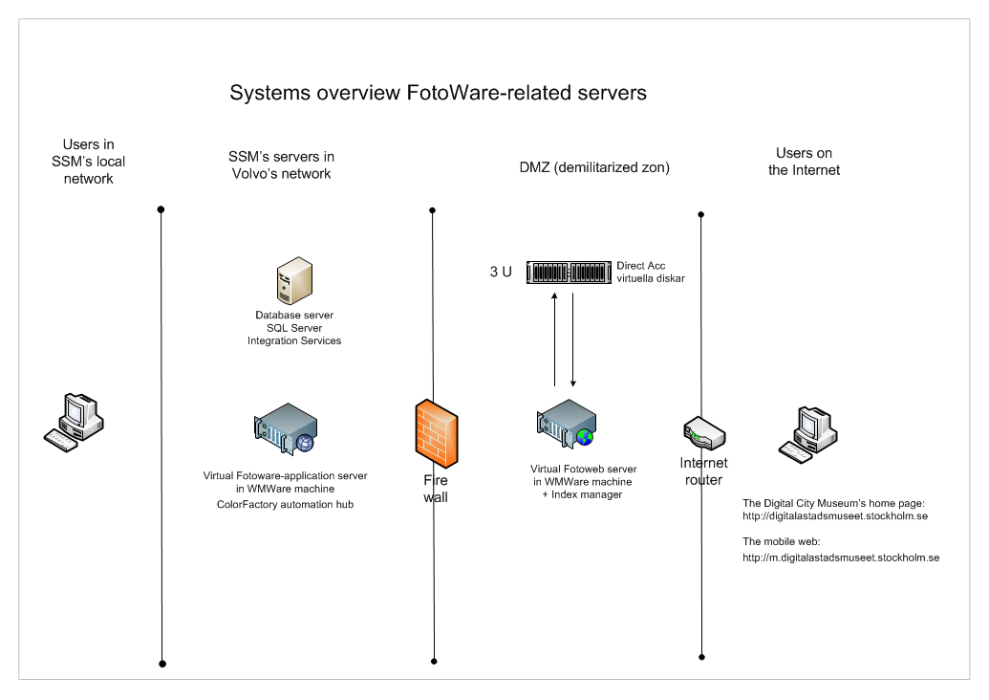
Systems overview

Slide 12
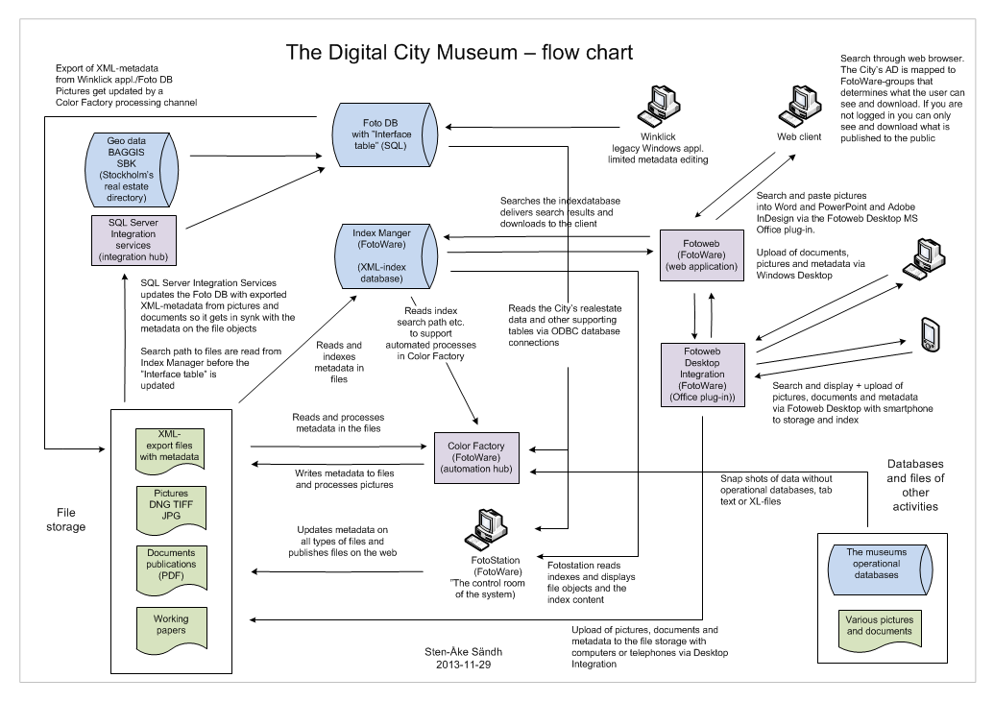

Slide 13





The FotoWare-system
Indexes metadata in pictures and documents as well as the text inside the documents and builds a searchable XML-database
Automates workflows, processes metadata and improves
the pictures with the help of Index Manager
Handles the user communication, searches and downloads via
Fotoweb’s webapplication
”The control room” – handles pictures, documents, metadata
and workflowactions. Publishes objects on the Fotoweb
Plug-in to MS Office
makes it possible to search pictures from within Word and
PowerPoint as well as Adobe InDesign and Photoshop and
paste pictures into their documents and presentations.
- makes it possible to upload pictures and documents to Fotoweb
via Windows desktop.

Slide 14
Key Techniques
The XMP (Extensible Metadata Platform) metadata standard makes it possible to tie metadata to any fileformat .
The metadata is stored within the XMP compatible files (DNG, TIFF, JPEg and PDF)
A must on the Internet.
The index system makes everything searchable and makes it possible to automate the photo processes using FotoWare’s automation hub Color Factory (the gem of the system)
Altered web templates admit a dynamic display only of the fields containing data. This gives the possibility to handle very different datasources and datatypes in one user interface despite we have houndreds of different fields to display
The ”Interface tabels” (our most important contribution to the system design) sits between FotoWare and our SQL databases and makes it possible to integrate the SQL databases with FotoWare and push data into any file object. It can also be used to stor file based data from any other source as XL-files or TEXT-files that we want to pusch into the files (conversion).
DNG the common RAW file format (Adobe Digital Negative)
a key in our efficient photo workflows

Slide 15
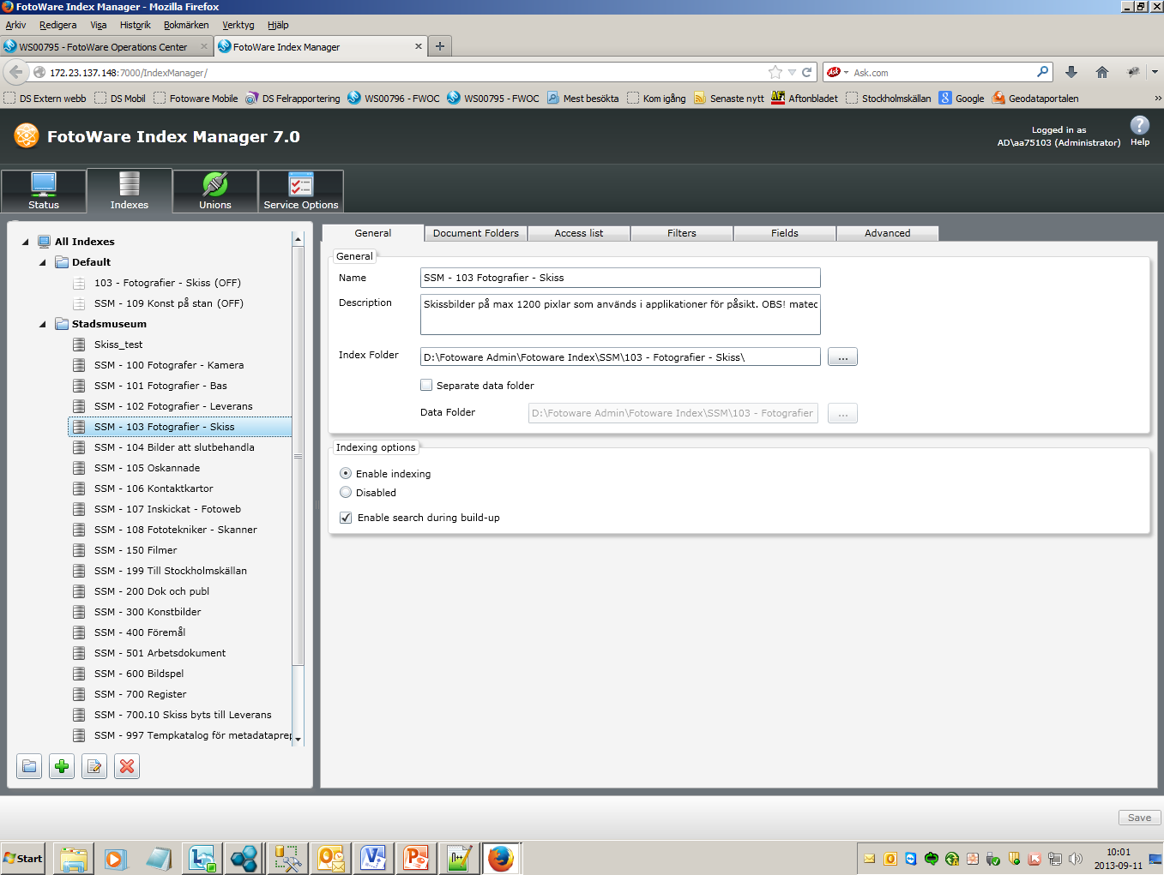
Index Manager
Indexes files and folders and serves the other systemparts with fileinfo and metadata.
Very powerfull and scalable. Manages to handle miljons of files with short response time

Slide 16
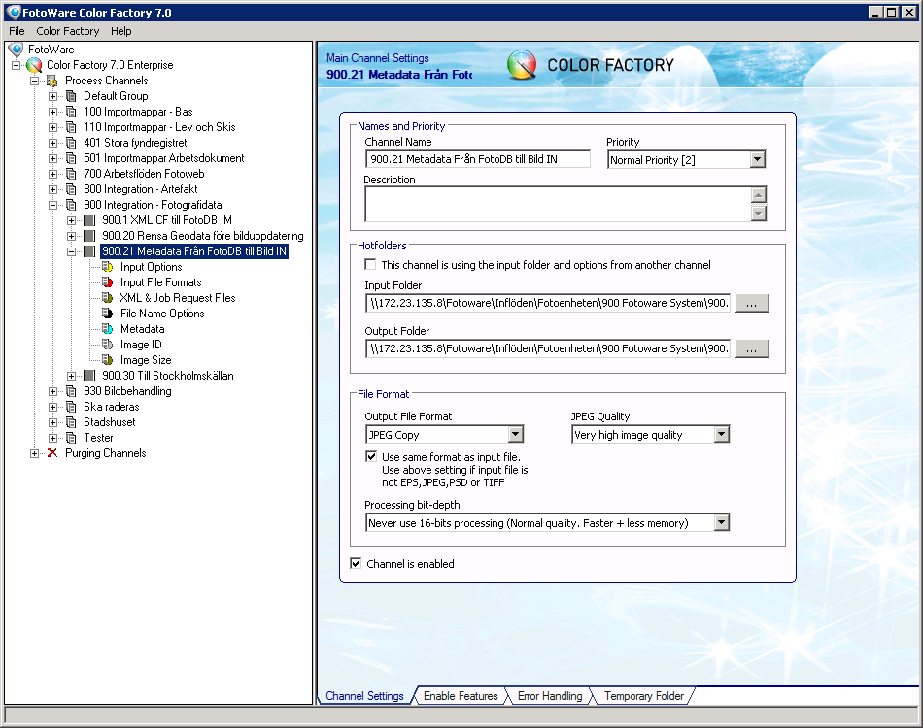
Color Factory – the automation hub the jewel in the FotoWare-system

Slide 17
Color Factory – the ”processing channels”
Automatic processing
of metadata and pictures
In folder
Out folder
In data comes both from
Fotostation and the legacy application Winklick or CF channels ”upstream” of the workflow
Out data folders can be
in data folders in channels
downstream of the workflow
Note!
Channels can be linked in chains, which
make Color Factory very flexible

Slide 18
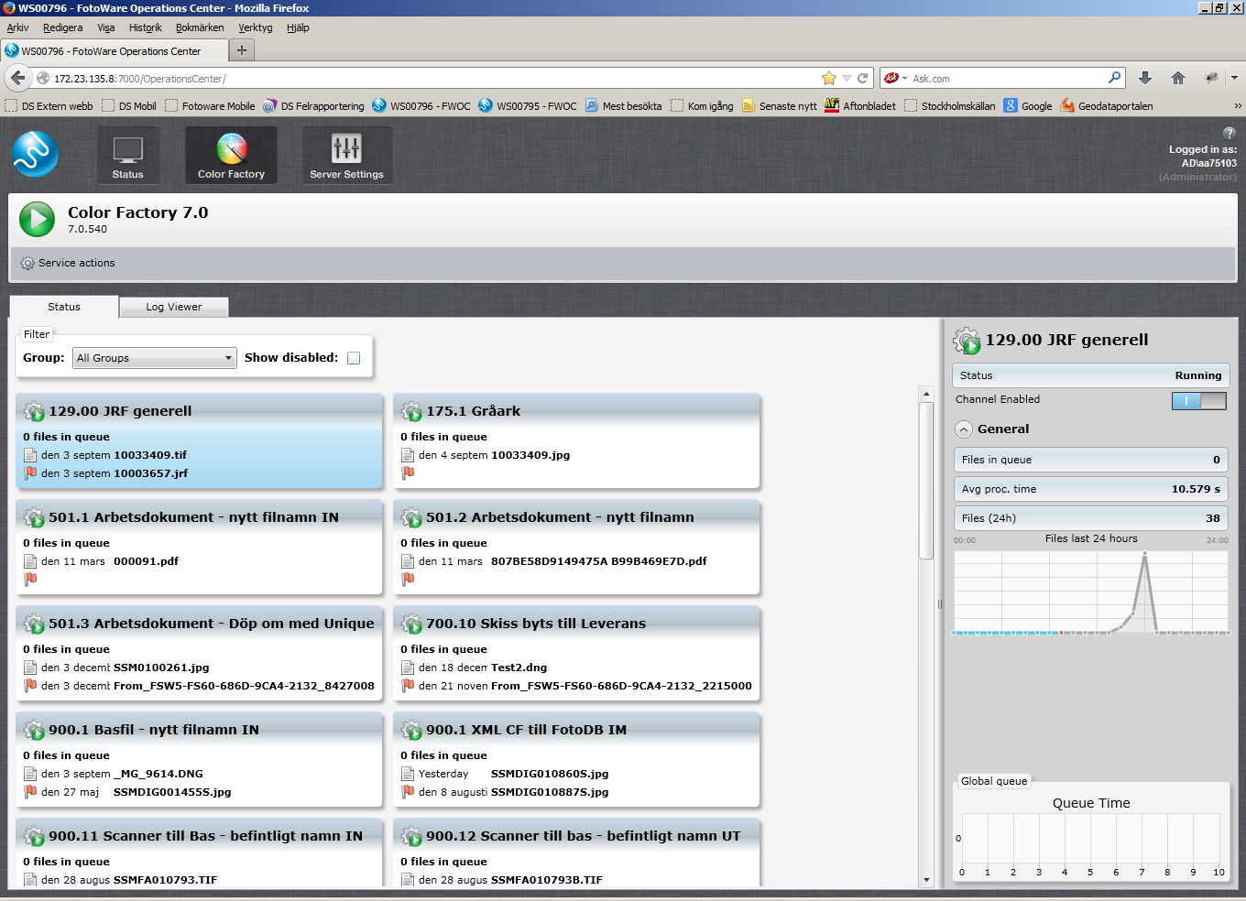
Color Factory – managing the automation hub

Slide 19
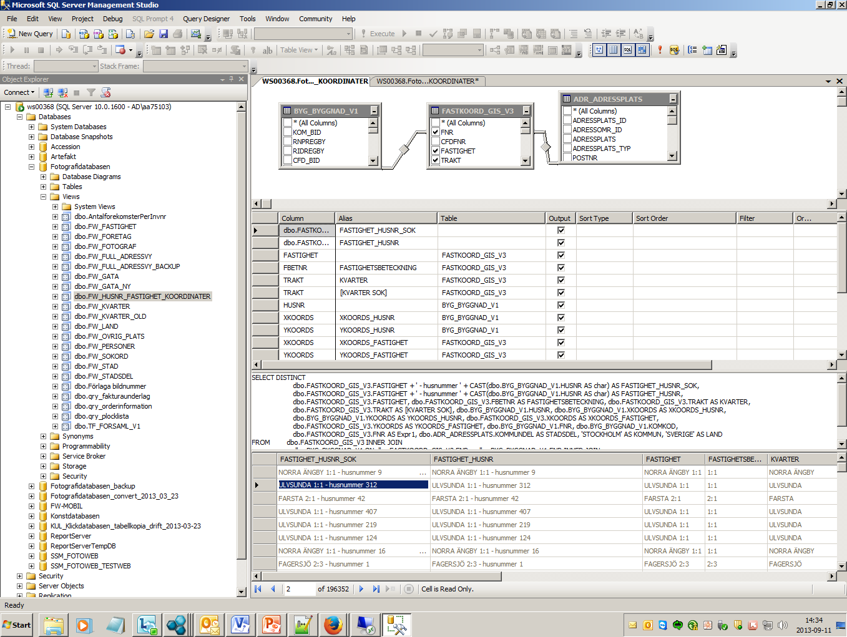
Microsoft SQL Server
Relation database : here we build the views we use in i Fotostations metadata forms

Slide 20
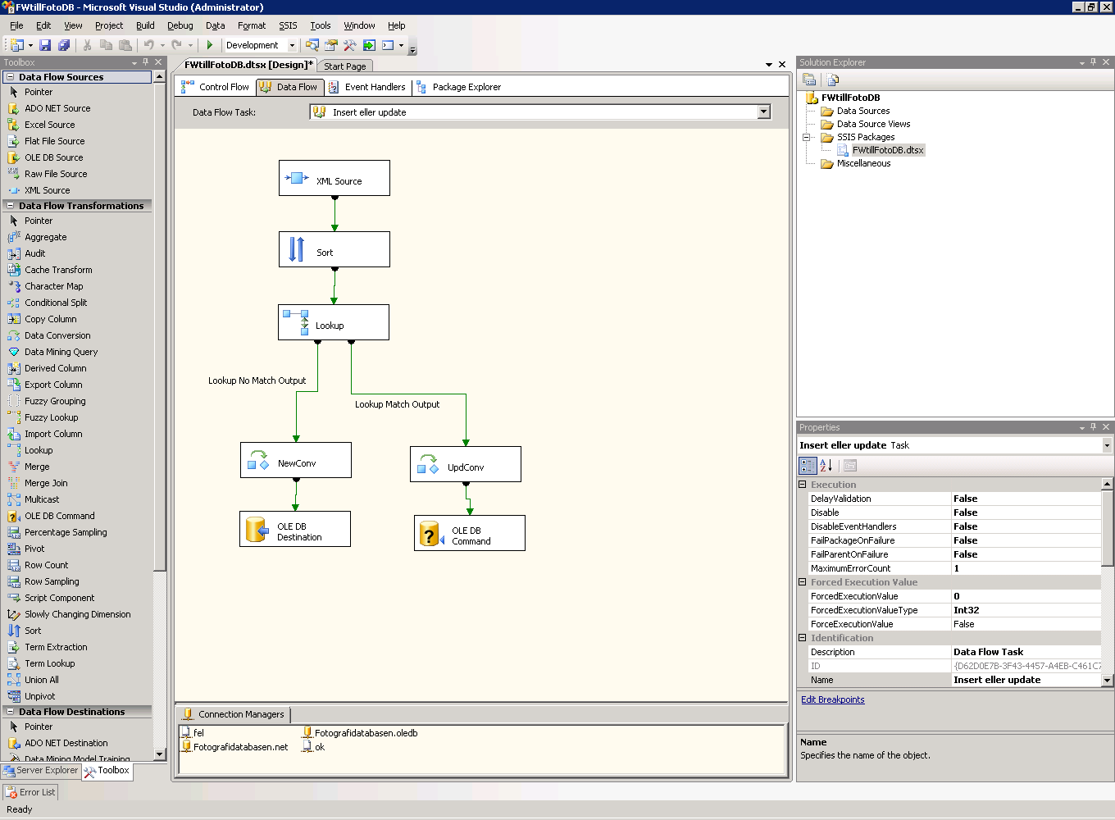
Microsoft SQL Server – Integration Services
Integration Services in an advanced ETL tool (Extract, Transform and Load)
A toolbox that makes integration possible with most other systems on the market

Slide 21
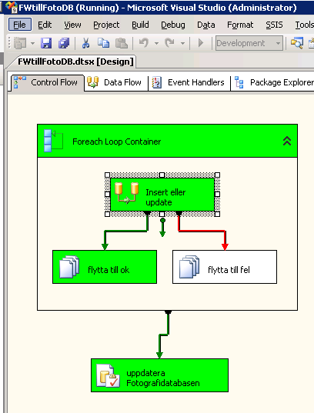
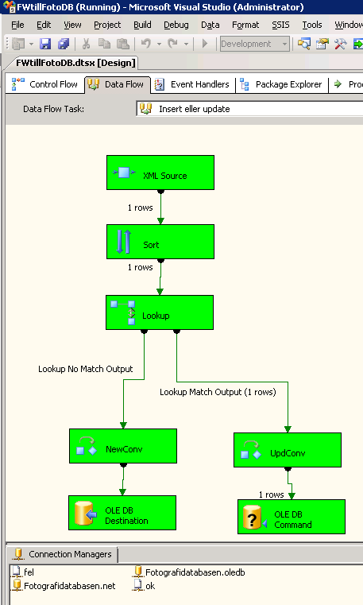
Microsoft SQL Server – Integration Services
With a so called SSIS task our Photo database gets updated with XML data from FotoWare

Slide 22
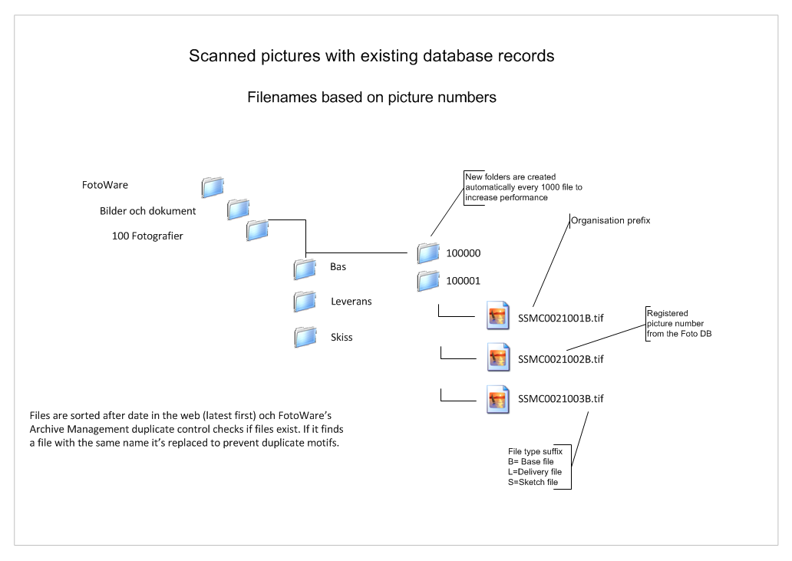
Filenames and folders – scanned pictures

Slide 23
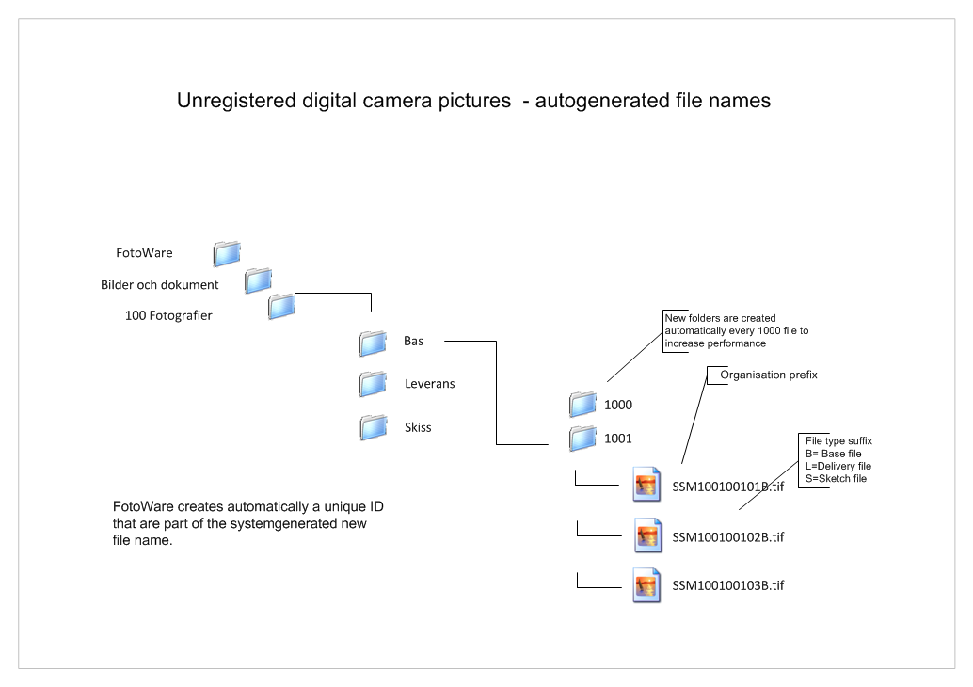
Filenamnes and folders – pictures from digital cameras

Slide 24
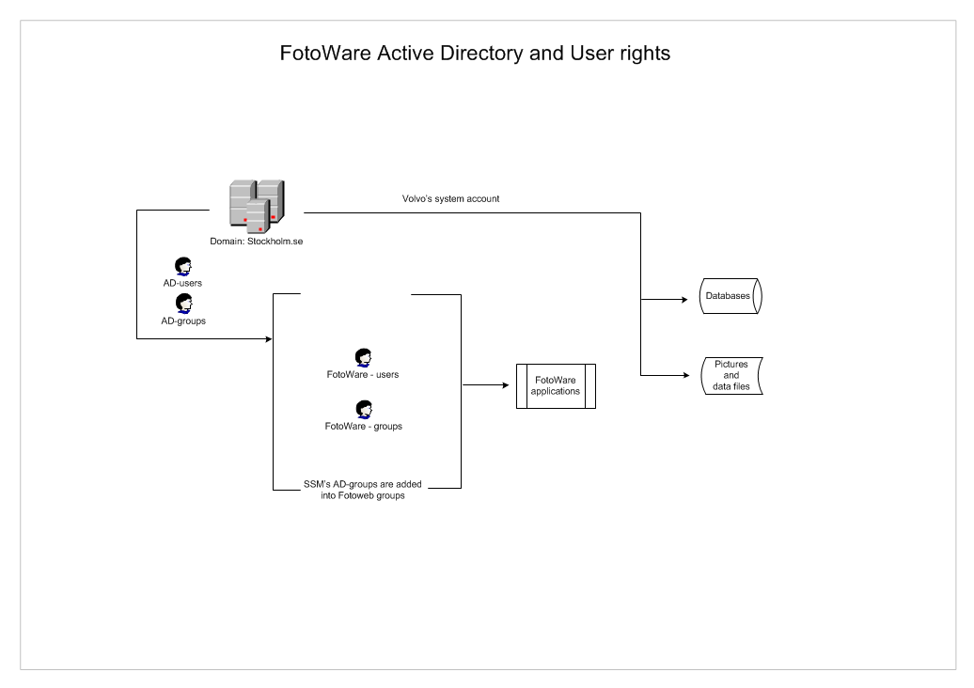
User rights - overview

Slide 25
system OVERVIEW - CLIENTS

Slide 26
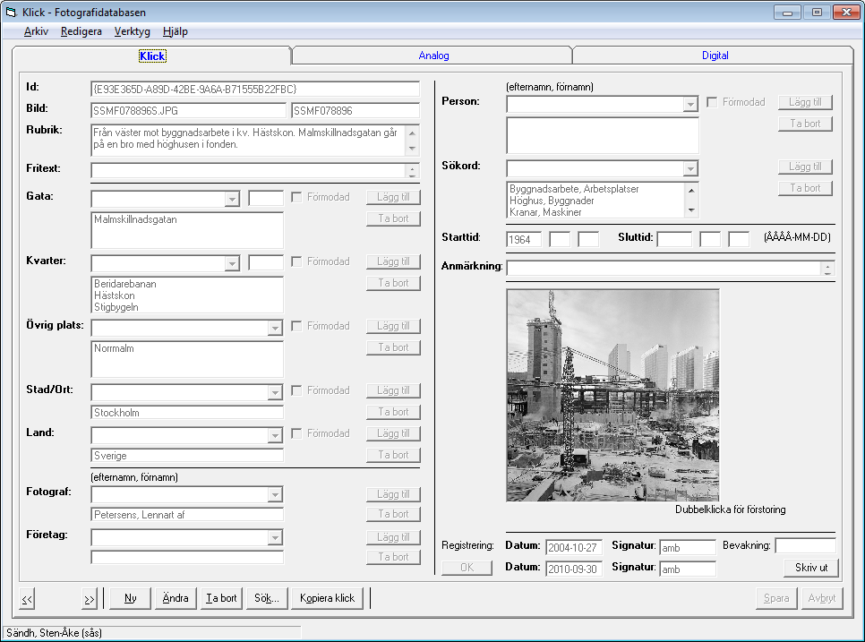
The legacy application Winclick (SQL-application)
We have a hot link between Winklick and the Photo database and FotoWare and the link works both ways on data common to both systems. Though a few antiqarian matters are still handled solely in the old application.

Slide 27
Main workflows for photographs
Loading pictures taken with camera (DNG) and basic metadata – auto filename
Loading pictures taken with camera (DNG) and basic metadata – existing filename
Loading scanned pictures – existing filename
Removal of pictures
Postprocessing of all kinds of existing basefiles
(creates new delivery files and sketch files (previews) automatically)
Updating of metadata
(only done on sketch files. Delivery files inherits metadata from the database
when files are exported from the system)

Slide 28
Other types of photo processes
Converting RAW to DNG
Invertering negative to positive
Mirroring
Auto picture enhancements (sharpening, changing contrast e.t.c.)
Error reporting
Publishing on webb
Updataing metadata – batch updates e.t.c.
Exporting to ”the Stockholm source / Stockholmskällan”
(Educational resours for school children and an interested public)
Stockholmskällan is a joint venture between bl.a. the City Museum, the City
Archive and a few other sources)

Slide 29
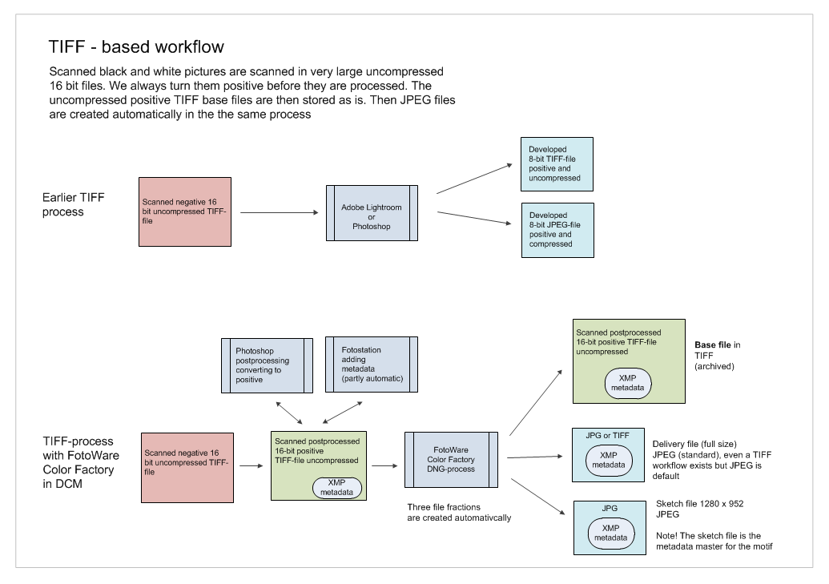
TIFF-based workflow – scanned TIFF pictures

Slide 30
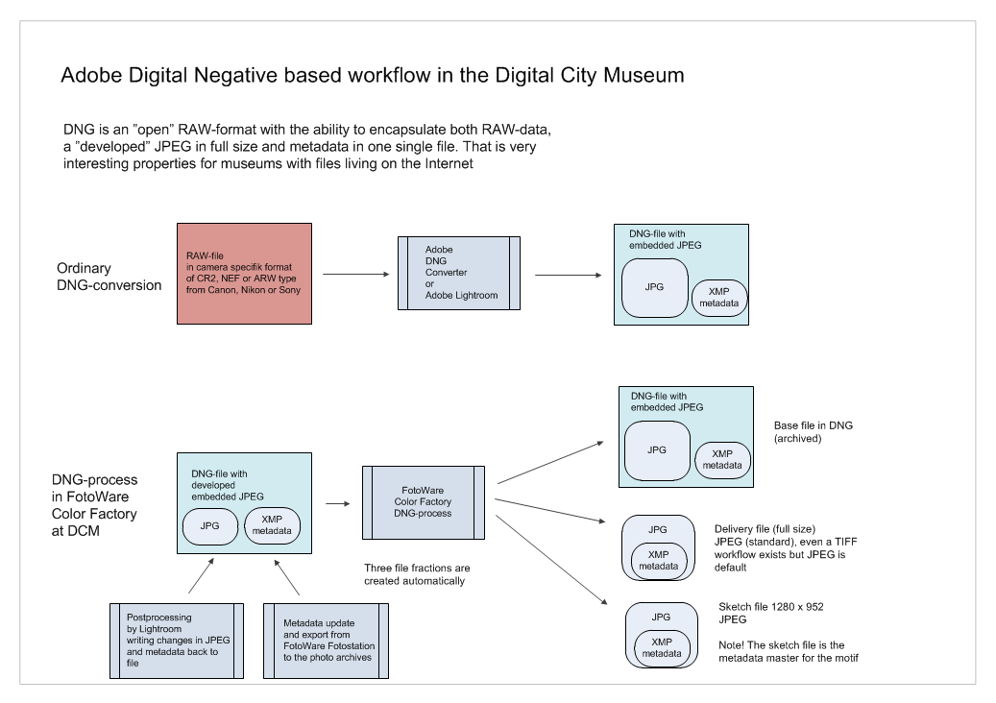
DNG based workflow – RAW-pictures

Slide 31
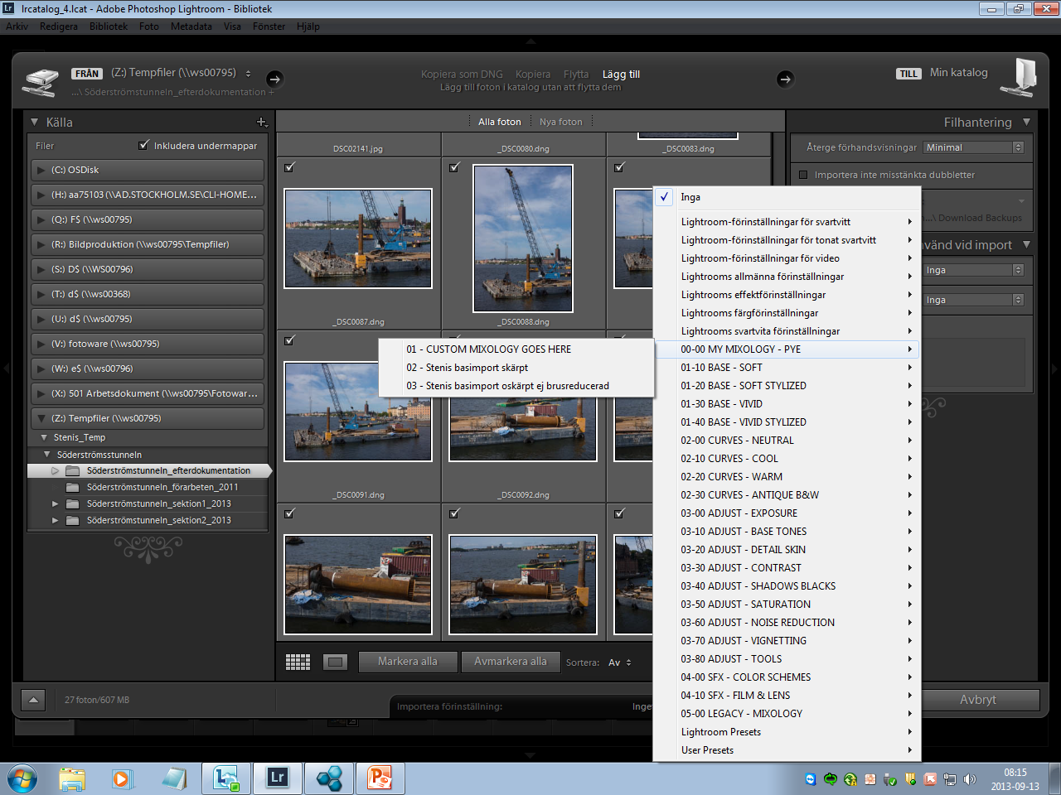
1. Pictures taken with digital camera efficient import of DNG RAW pictures with ”post processing presets”
(Adobe Lightroom)

Slide 32
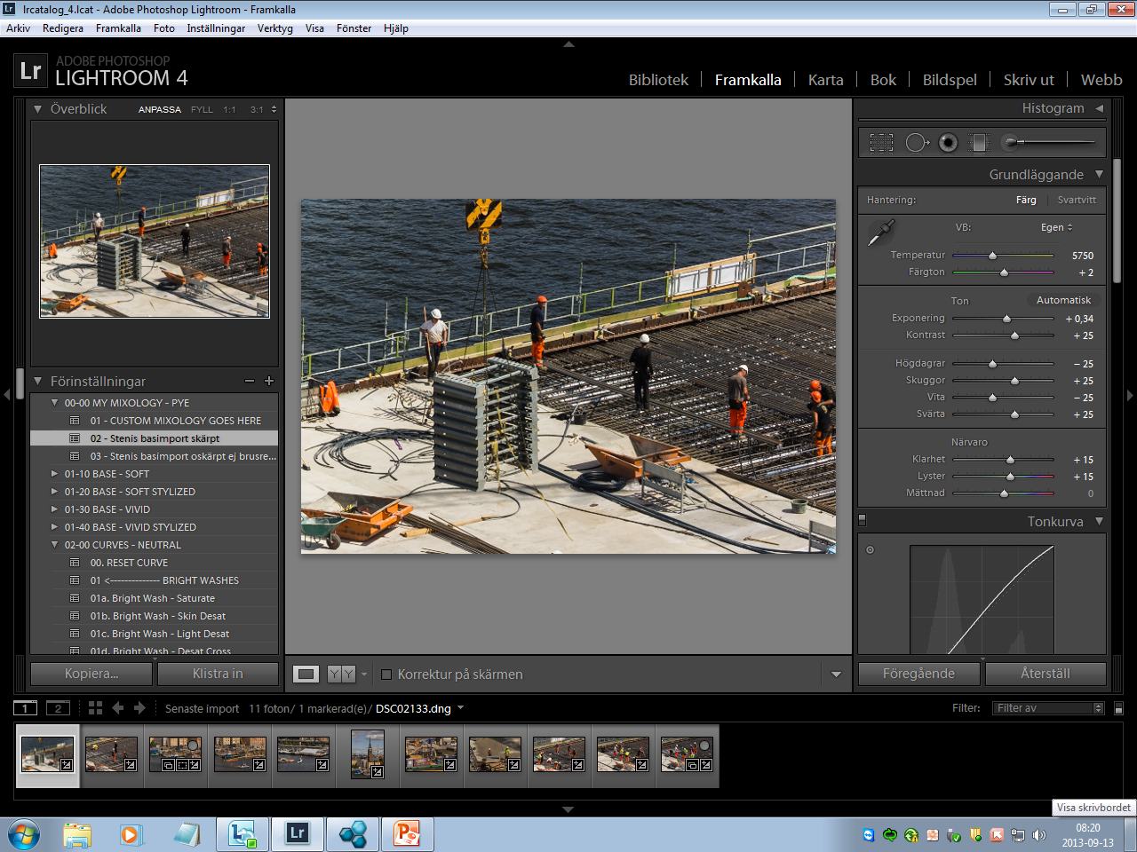
2. Pictures taken with digital camera
With presets you don’t need to pull every single slider on every single picture in Lightroom

Slide 33
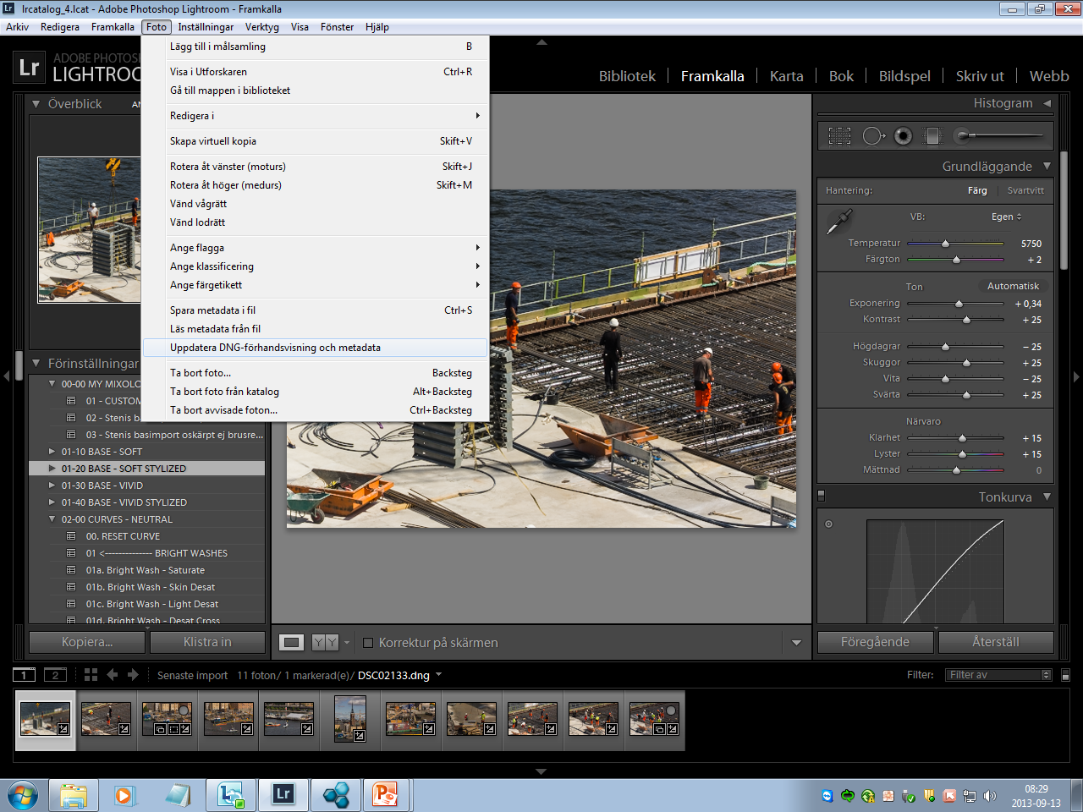
3. Pictures taken with digital camera
Picture enhancements and changes in metadata are written back to the files on disk
(embedded JPEG-previews in full size = all pixels from RAW)

Slide 34
Fotostation (Windows-application)
The ”control room” of the Digital City Museum

Slide 35
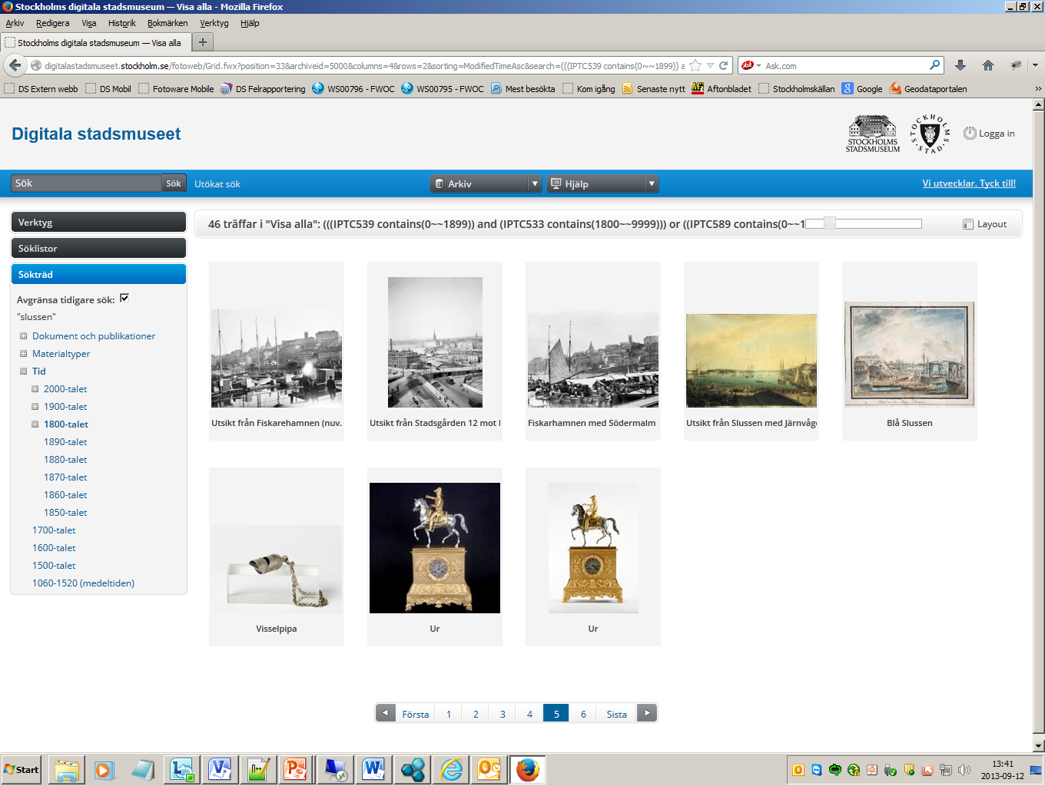
Fotoweb grid view (webbapplication)
The ”display window” of the Digital City Museum

Slide 36
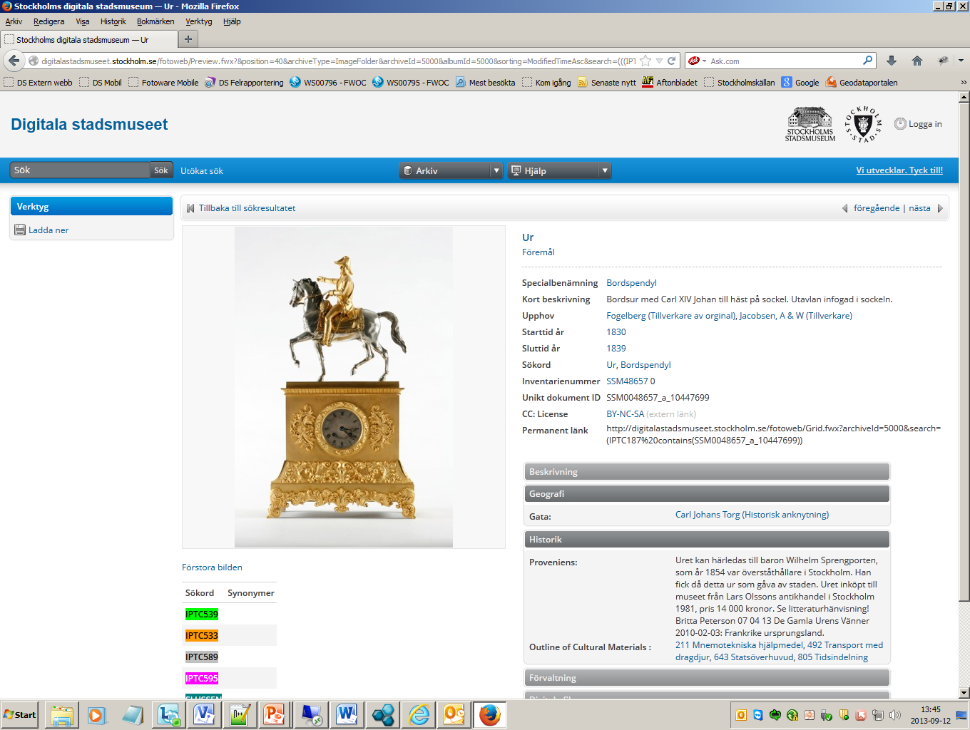
Fotoweb detail view only fields/elements with text are displayed that’s the key to make all types of material searchable in one single search interface

Slide 37
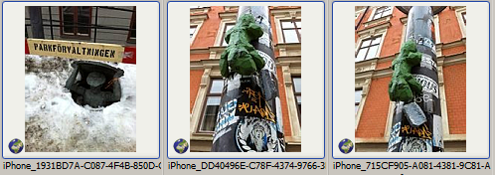
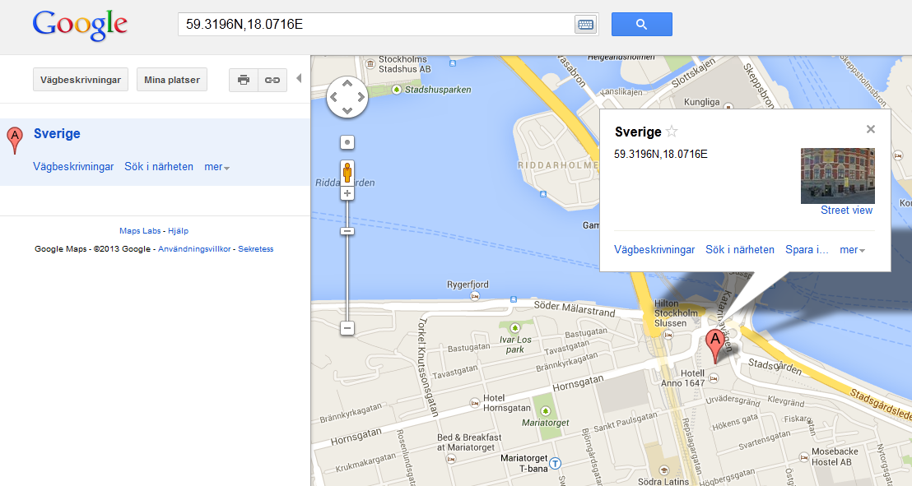
The Digital City Museums integration with Google Maps
Positioning
Pictures taken with cameras with
GPS, and have latitude/longitude
coordinates in their EXIF-data,
will be positioned in the Google Maps
in both Fotoweb and Fotostation

Slide 38
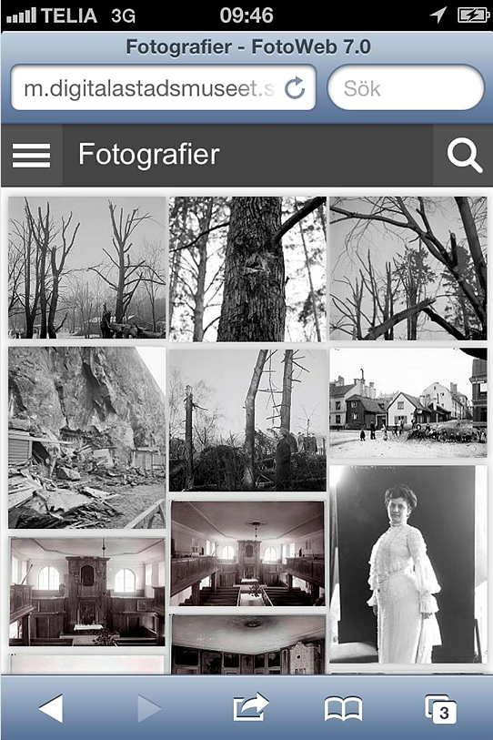
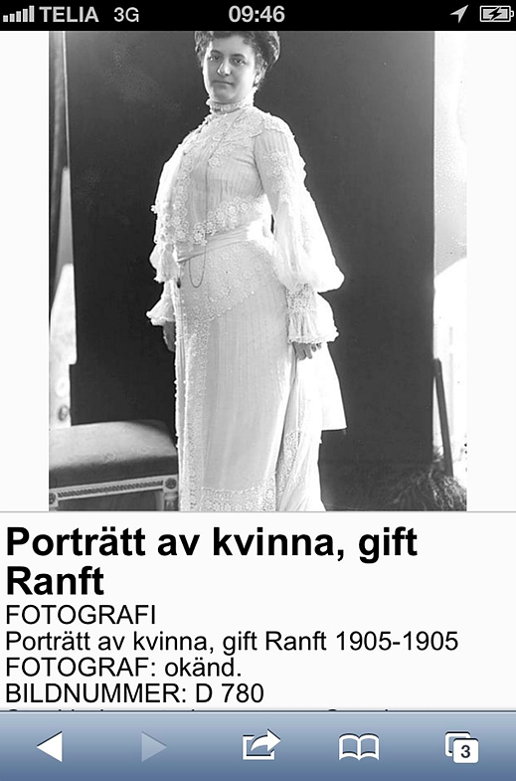
Fotoweb mobile (mobile application) at: m.digitalastadsmuseet.stockholm.se

Slide 39
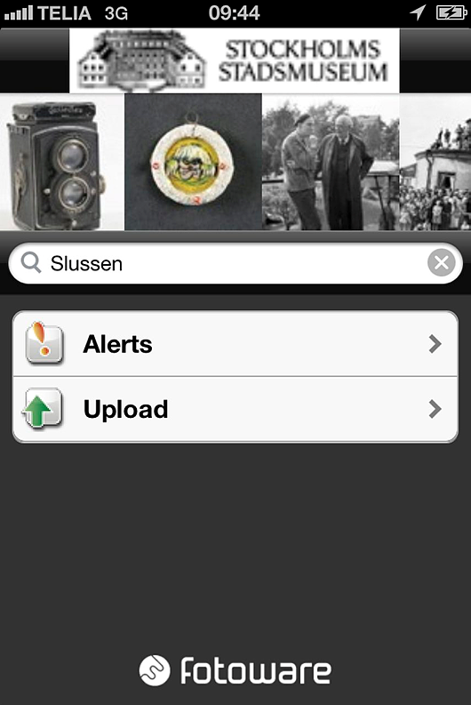
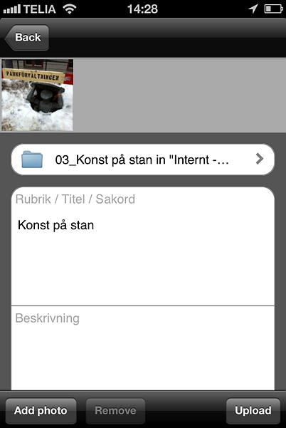
Fotoweb App (mobile app)
Iphone- och Android apps for viewing/reading pictures and metadata.
You can even use it for uploading mobile taken pictures and add metadata to them

Slide 40
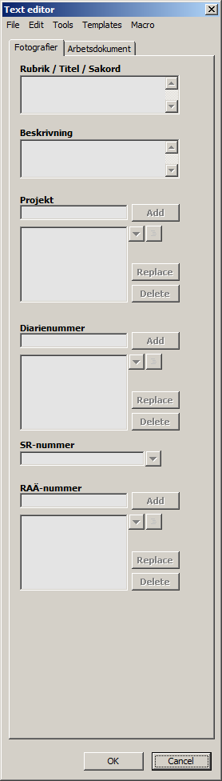
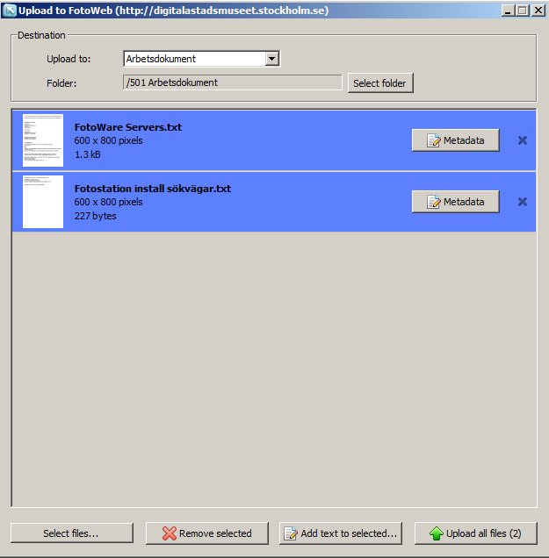

Fotoweb Desktop Integration - Windows
Uploading of all sorts of file data to the web
via dropping files on an icon on Windows Desktop.
Batch editing of metadata possible via attached forms

Slide 41
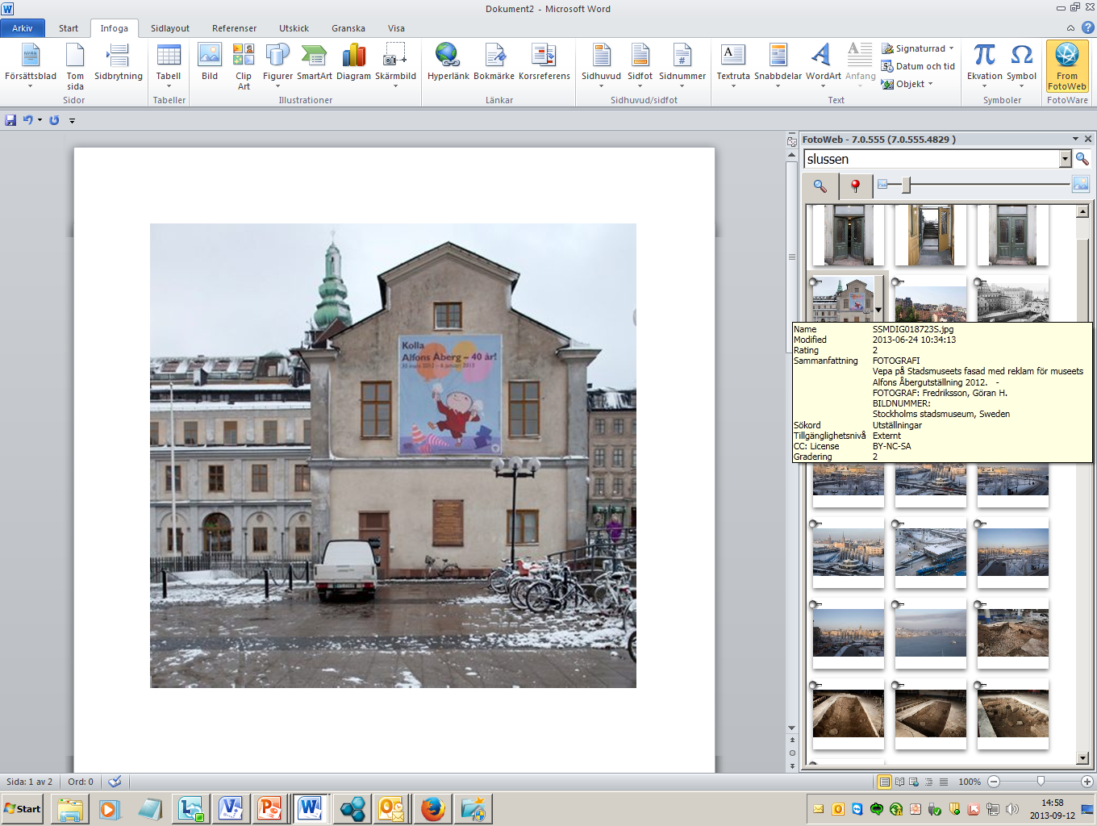
Fotoweb Desktop Integration – MS Office
Search and ”drag and drop” – direct i Word, PowerPoint and In Design
Drag and drop

Slide 42
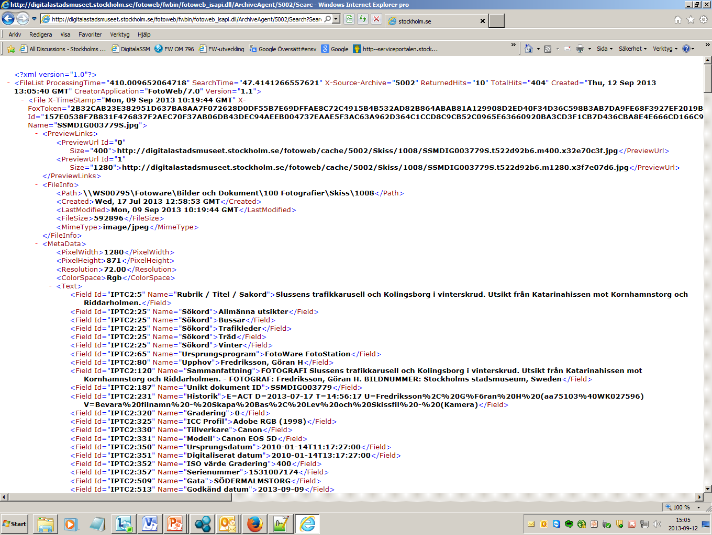
Open Data with Fotoweb Archive Agent
Archive Agent is a web service in Fotoweb that serves applications like Fotoweb, Fotostation, Foto- web Desktop and other applications accessing Fotoweb, with pictures, documents and metadata.
With simple http calls, we can get Fotoweb to deliver metadata and links to pictures and documents. Pictures can even get scaled to your liking with simple commands. Theese data can then be used to build apps around.
Example: a simple http call that delivers metadata from all pictures with ”Slussen” in their metadata
http://digitalastadsmuseet.stockholm.se/fotoweb/fwbin/fotoweb_isapi.dll/ArchiveAgent/5002/Search?Search="Slussen"&MaxHits=10&PreviewSize=400&PreviewSize=1280&FileInfo=1&MetaData=1

Slide 43
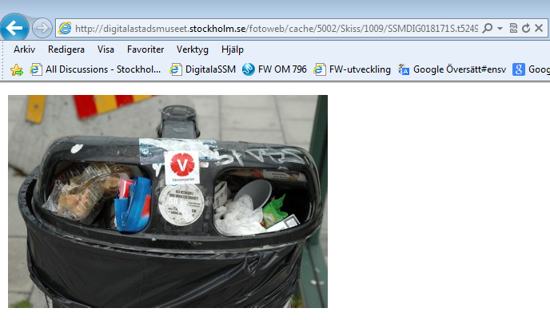
Open Data with Fotoweb Archive Agent
http://digitalastadsmuseet.stockholm.se/fotoweb/cache/5002/Skiss/1009/SSMDIG018171S.t52496e2f.m400.xd27714b8.jpg
Example 1: In the answer to the http call ”Slussen” in the slide above, we can even find links to the the pictures. The size is specified direct in the http call. In this case 400 pixels. The answer to the call above is the picture itself.

Slide 44
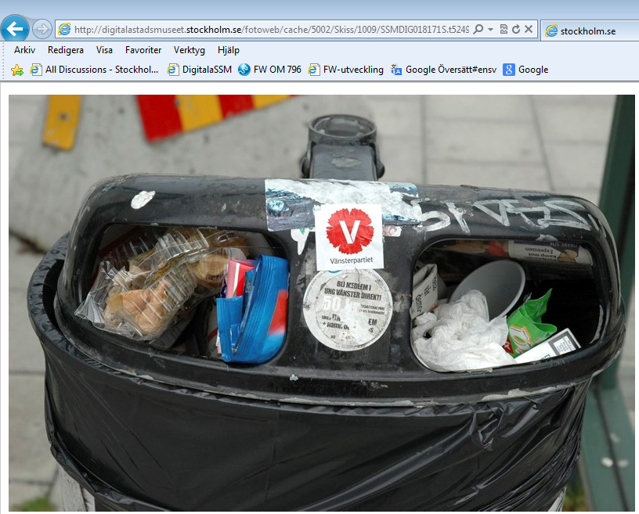
Open Data with Fotoweb Archive Agent
http://digitalastadsmuseet.stockholm.se/fotoweb/cache/5002/Skiss/1009/SSMDIG018171S.t52496e2f.m800.x6082ef79.jpg
Example 2: The size specified in this case is 800 pixels. The answer to the call above is the picture itself.

Slide 45
WRAP UP

Slide 46
A few important challenges
We have 3,5 miljon pictures stored and their technical quality is slowly detoriating. Today about 1% is scanned. We scan about 3000 pictures per year mostly to meet customer orders. There is a risk we will fail to preserve some of them before their content is eroded.
We are convinced FotoWare, used in an effective way may balance these problems a bit though.
Our historical pictures are mostly taken between 1840 and 1960 and they reflect a very homogenous population. Today about 10% of the population has an immigrant background. How can the City Museum get more relevant for these groups?
How can we get stockholmers – new and old – to take a more active part in the challenge of building new knowledge that includes all groups life experiences.
FotoWare has continued to develope during the project and we have got new tools like mobile web templates, telephone apps and Fotoweb Desktop, that improve the possibilities to collaborate. A new web will be released next year that will allow us to tie user comments and diskussions to each digital object. There is already a technical solution for the public to participate in complementing the metadata, so called crowd sourcing but we have not yet made it public.

Slide 47
In a near future
Now we will focus on:
getting as many as possible in the museum, photographers , antiquarians and everybody else employed by the Stockholm city, to use the web and the MS Office plug-in FotoWare Desktop Integration efficiently
publishing as much material as possible. More different datatypes and many more items are loaded into the system. Almost 70.000 so called ”grey sheets ” with mounted photograps will be added in a week or two.
helping the public to find the way to the Digital City Museum and find the way through our digital assets
The common web address: http://digitalastadsmuseet.stockholm.se
The mobile web address: http://m.digitalastadsmuseet.stockholm.se

Slide 48

FIN

